Slide 1
Designing 3D Mobility Model For Flying Ad – Hoc Networks Using NS3
Submitted by
Patrick Lamieno A 19BEC1055
M N Ram Kishore 19BEC1289
Vignesh S 19BEC1391
Under the Guidance
Dr. P. Vijayakumar
School of Electronics Engineering
VIT University, Chennai

Slide 2
Overview
Abstract
Introduction
Literature review
Proposed Idea
Reference

Slide 3
Abstract
A Flying Ad-Hoc Network (FANETs) is a group of Unmanned Aerial Vehicles (UAVs) which can complete their function without human intervention.
FANET is collection of small unmanned aerial vehicles (UAVs)
There are many mobility models that can be used to reproduce the behavior of the mobile nodes in an ad-hoc network.

Slide 4
Abstract
In which Gauss – Markov Model (GMM) is the most efficient one compared to any other existing models.
We have considered the various performance metrics such as moving speed, Latency.
Keywords : Gauss – Markov Model (GMM), UAV, Speed, Latency, Flying Ad-Hoc Networks

Slide 5
Introduction
UAVs – the pinnacle of electronics and aviation engineering miniaturized and honed to perfection.
Initial purposes of UAVs in the early stages of production was solely for military operations
In the late 2000s, the common people were made to experience hands-on experience the air superiority.

Slide 6
Introduction
In demand to High QoS in telecommunication sector, UAVs are now being used as access points instead of actual towers.
Flying Ad-Hoc networks play an essential role in addressing the above-mentioned problem in remote areas.
Swarm of UAVs controlled from GCS will act as access points in remote/inaccessible areas to give network coverage.

Slide 7
Introduction
GMM – Gauss – Markov mobility model is used as the primary model for simulation of personal communication service
There are various outdoor mobility models namely Random – walk, Random – waypoint, Random direction.
GMM is considered in this project due to its robustness and compatibility with FANET swarm.

Slide 8
Literature Review
Title | Author | Abstract
Optimized Unmanned Aerial Vehicles Deployment for Static and Mobile Targets Monitoring Elsevier | Fadi Al-Turjman, Hadi Zahmatkesh, Ibrhaim Al-Oqily, and Reda Daboul | The system proposes a optimized placement approach (OPA) to increase the drones’ visibility range. Thereby reducing the total number of drones. The results shows that by increasing the battery capacity of the drones, the drones’ visibility range would also increase and thus, the number of drones would be reduced
An Optimized Communication Scheme for Energy Efcient and Secure Flying Ad‑hoc Network (FANET) Springer | Mayank Namdev, Sachin Goyal, Ratish Agarwal | The system proposes a whale optimization algorithm based optimized link state routing for energy efficient and secure FANET. Better efficiency of WOA-OLSR in parameters such as: packet delivery ratio, end to end delay, energy utilization, throughput, and time complexity

Slide 9
Literature Review
Title | Author | Abstract
Enhanced Deployment Strategy for the 5G Drone-BS Using Artificial Intelligence IEEE | Fadi Al-turjman, Joel Poncha Lemayian, Sinem Alturjman, And Leonardo Mostarda | The proposed system uses Simulated Annealing(SA) and Genetic Algorithm (GA) to estimate the best location to place the optimal number of drones used. The results suggests that SA takes precedence when the coverage area is small. GA can provide better results in timely manner for outdoor UAV applications.
Q-FANET: Improved Q-learning based routing protocol for FANETs Elsevier | Luis Antonio L.F. da Costa, Rafael Kunst, Edison Pignaton de Freitas | The proposed system uses Q-Learning algorithm and reinforcement learning-based routing protocols. The novelty of this system results in lower delay, a minor increase in packet delivery ratio, and significant lower jitter

Slide 10
Literature Review
Title | Author | Abstract
Local Mutual Exclusion algorithm using fuzzy logic for Flying Ad hoc Networks. Elsevier | Ashish Khanna , Joel J.P.C. Rodrigues, Naman Gupta , Abhishek Swaroop, Deepak Gupta | This system incorporates leader-based algorithm called RCLME to solve the problem of Local Mutual Exclusion. The use of fuzzy logic and request collector improves the efficiency to a high level. RCLME outperforms other models when the number of nodes is large.
DPTR: Distributed priority tree-based routing protocol for FANETs Elsevier | Vishal Sharma, Ravinder Kumar, Neeraj Kumar | This system uses a felicitous routing protocol to handle transmission in this mutually coordinated system. The protocol is derived over distributed Red–Black (R-B) tree. The results shows that there is sufficient channel utilization, packet delivery ratio, end to end delay.

Slide 11
Literature Review
Title | Author | Abstract
Evaluation of Flying Ad Hoc Network Topologies, Mobility Models, and IEEE Standards for Different Video Applications ARO-THE SCIENTIFIC JOURNAL OF KOYA UNIVERSITY | Ghassan A. QasMarrogy | This system proposes different types of realistic scenarios are been evaluated and analyzed. 2 routing protocols were selected AODV and OLSR. 3 different mobility models were simulated GMM, RWPM, and SCRM. The result shows that Gauss–Markov mobility model gives the highest result using AODV and lowest delay.
A Hybrid Communication Scheme for Efficient and Low-Cost Deployment of Future Flying Ad-Hoc Network (FANET) MDPI | Muhammad Asghar Khan, Ijaz Mansoor Qureshi and Fahimullah Khanzada | The system propose a hybrid wireless communication scheme to utilize the features of the high data transmission rate. A multi-layer UAV ad-hoc network is the most suitable architecture for networking a group of heterogeneous UAVs 802.15.1 is preferred due to its low-cost, low power consumption, and longer transmission range for FANET. The Results suggests there is a significantly reduces communication cost and improves the network performance in terms of throughput and delay.

Slide 12
Literature Review
Title | Author | Abstract
Application of bee colony algorithm for FANET routing IEEE Explore | Alexy V. Leonov | The system proposes a bio-inspired algorithm which mimeograph's the behavior of bees, also called Bees Algorithm. The result proves that Bees algorithm is able to optimally control swarm of drones without any wild drones.

Slide 13
Proposed Idea
To implement Gauss – Markov mobility model for Flying Ad-Hoc Networks using ns3.
The model will be assistive in predetermining the swarm’s flight plan through simulation in ns3.
Expected end result – Determining swarm’s speed, direction, flow control, transmission rate and throughput.

Slide 14
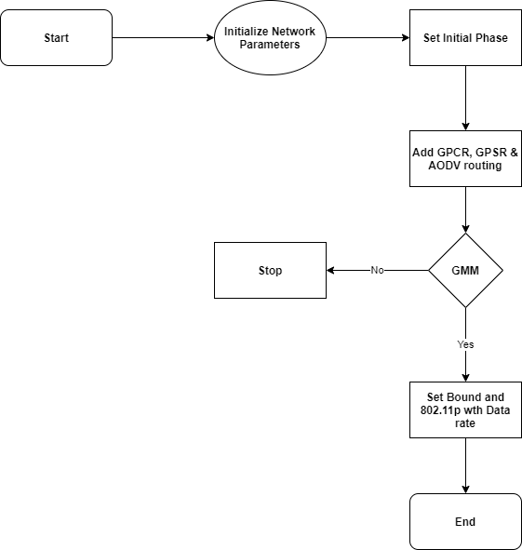
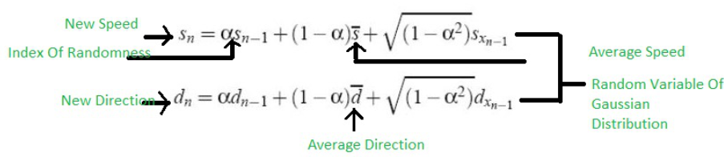
Block Diagram and Mathematical equation

Slide 15
References
[1] Fadi Al-Turjman, Hadi Zahmatkesh, Ibrhaim Al-Oqilya and Reda Daboul, “Optimized Unmanned Aerial Vehicles deployment for static and mobile targets monitoring”, Computer Communications,Volume 149,pp 27-35, 2020
[2] Namdev, M., Goyal, S. & Agarwal, R. “An Optimized Communication Scheme for Energy Efficient and Secure Flying Ad-hoc Network (FANET)”. Wireless Personal Communications 120, pp:1291–131, September 2021

Slide 16
References
[3] F. Al-Turjman, J. P. Lemayian, S. Alturjman and L. Mostarda, "Enhanced Deployment Strategy for the 5G Drone-BS Using Artificial Intelligence," in IEEE Access, volume. 7, pp. 75999-76008, June 2019
[4] Luis Antonio L.F. da Costa, Rafael Kunst, Edison Pignaton de Freitas, “Q-FANET: Improved Q-learning based routing protocol for FANETs”, Computer Networks, Volume 198, October 2021, 108379

Slide 17
References
[5] Ashish Khanna, Joel J.P.C. Rodrigues, Naman Gupta, Abhishek Swaroop, Deepak Gupta, “Local Mutual Exclusion algorithm using fuzzy logic for Flying Ad hoc Networks”, Computer Communications, vol. 156, pp. 101-111, April 2020
[6] Vishal Sharma, Ravinder Kumar, Neeraj Kumar, “DPTR: Distributed priority tree-based routing protocol for FANETs”, Computer Communications, Volume 122, pp. 129-151, June 2018

Slide 18
References
[7] G. QasMarrogy, “Evaluation of Flying Ad Hoc Network Topologies, Mobility Models, and IEEE Standards for Different Video Applications”, ARO, vol. 9, no. 1, pp. 77-88, May 2021.
[8] M. Khan, I. Qureshi, and F. Khanzada, “A Hybrid Communication Scheme for Efficient and Low-Cost Deployment of Future Flying Ad-Hoc Network (FANET),” Drones, vol. 3, no. 1, p. 16, Feb. 2019
[9] A. V. Leonov, "Application of bee colony algorithm for FANET routing," 2016 17th International Conference of Young Specialists on Micro/Nanotechnologies and Electron Devices (EDM), 2016, pp. 124-132, March 2016.

